Slide 1
ReasonED.io:
Feasibility
Team Crystal
Emily Louk
Alysha Morgan
Areeb Nabi
June Troyer
Dakota Dawe
Nolan Marchione
Devan Hill
CS 410 Professional Workforce Development Ⅰ
11/15/23
Notes:
Good Afternoon everyone, we are Team Crystal and we will be presenting the Feasibility details for our software solution: ReasonED

Slide 2
Table of Contents
3 Team Members
5 Terms
7 Problem Background
10 Statistics
11 Problem/Characteristics
13 Current Process Flow
14 Solution/Features
16 Customers/End Users
17 Solution Flow
18 Competition
20 Risk Analysis
23 MFCD
24 Conclusion
25 References
CS 410
ReasonED.io | Feasibility
Notes:
Here is a quick overview of the slide sequence we're gonna follow today. We'll go over some important terms to make sure everyone's on the same page, explain the background context of our problem, pinpoint the problem itself, and then introduce our solution and the practicalities of it.

Slide 3


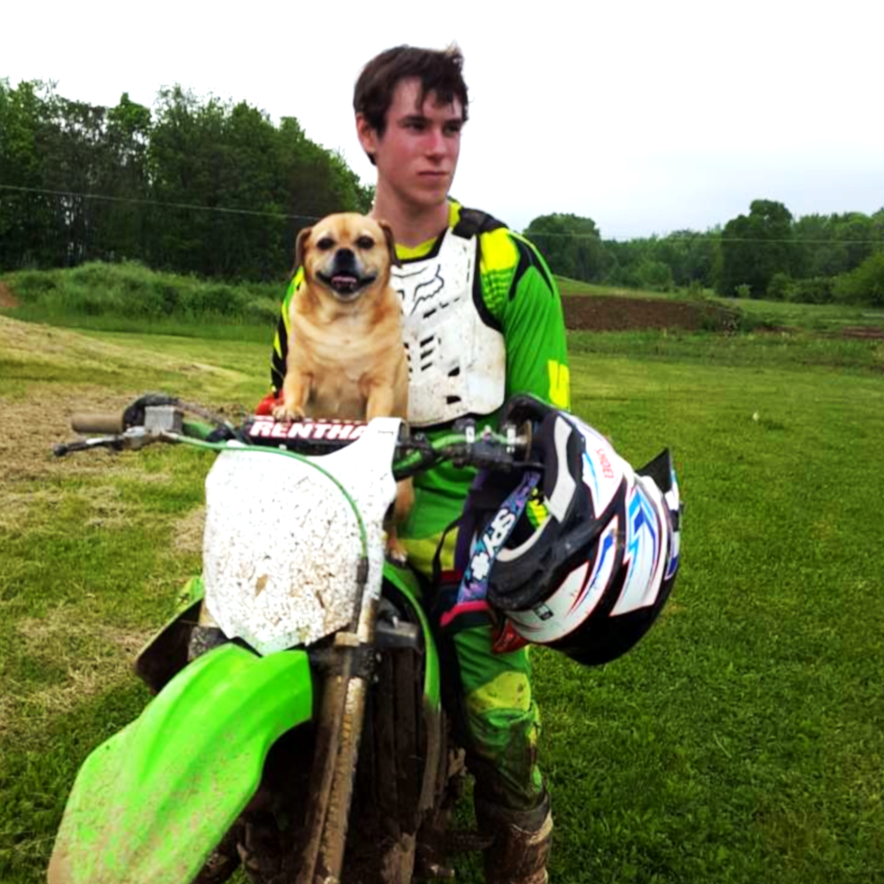

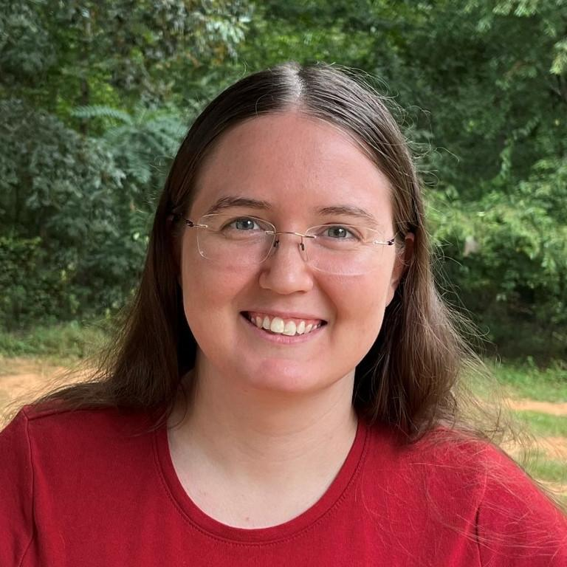
Biographies
Emily Louk
Dakota Dawe
Areeb Nabi
June Troyer
Emily is a senior undergraduate at ODU. She has an Associate degree in Information Systems and will pursue software engineering after earning her B.S.C.S.. At ODU, she has interned with the Game Studies program as a developer and participated in a research project. She is interested in developing educational tools, video games, and mobile apps.
Dakota is still finishing his Associates degree at LFCC while working through the remaining courses at ODU for his Bachelors. Dakota is currently working as a games programmer selling plugins on the Unreal Engine marketplace as well as a contract programmer for Small Indie Company developing their upcoming title “We The People”.
Areeb is a senior at Old Dominion University pursuing his undergraduate degree in Computer Science. He recently completed a 10-week summer internship with Automatic Data Processing (ADP), honing his skills as a Full-Stack Developer. Areeb specifically enjoys front-end development, and working with JavaScript libraries such as React, Express, and Node.js.
June is a senior Computer Science undergraduate at ODU in the linked Master’s program. She has an associate degree in Science from Piedmont Virginia Community College. She enjoys helping others explore new topics and improve their skills and reasoning.
CS 410
ReasonED.io | Feasibility
Notes:
Before we dive in we'll take a quick minute to introduce ourselves.

Slide 4


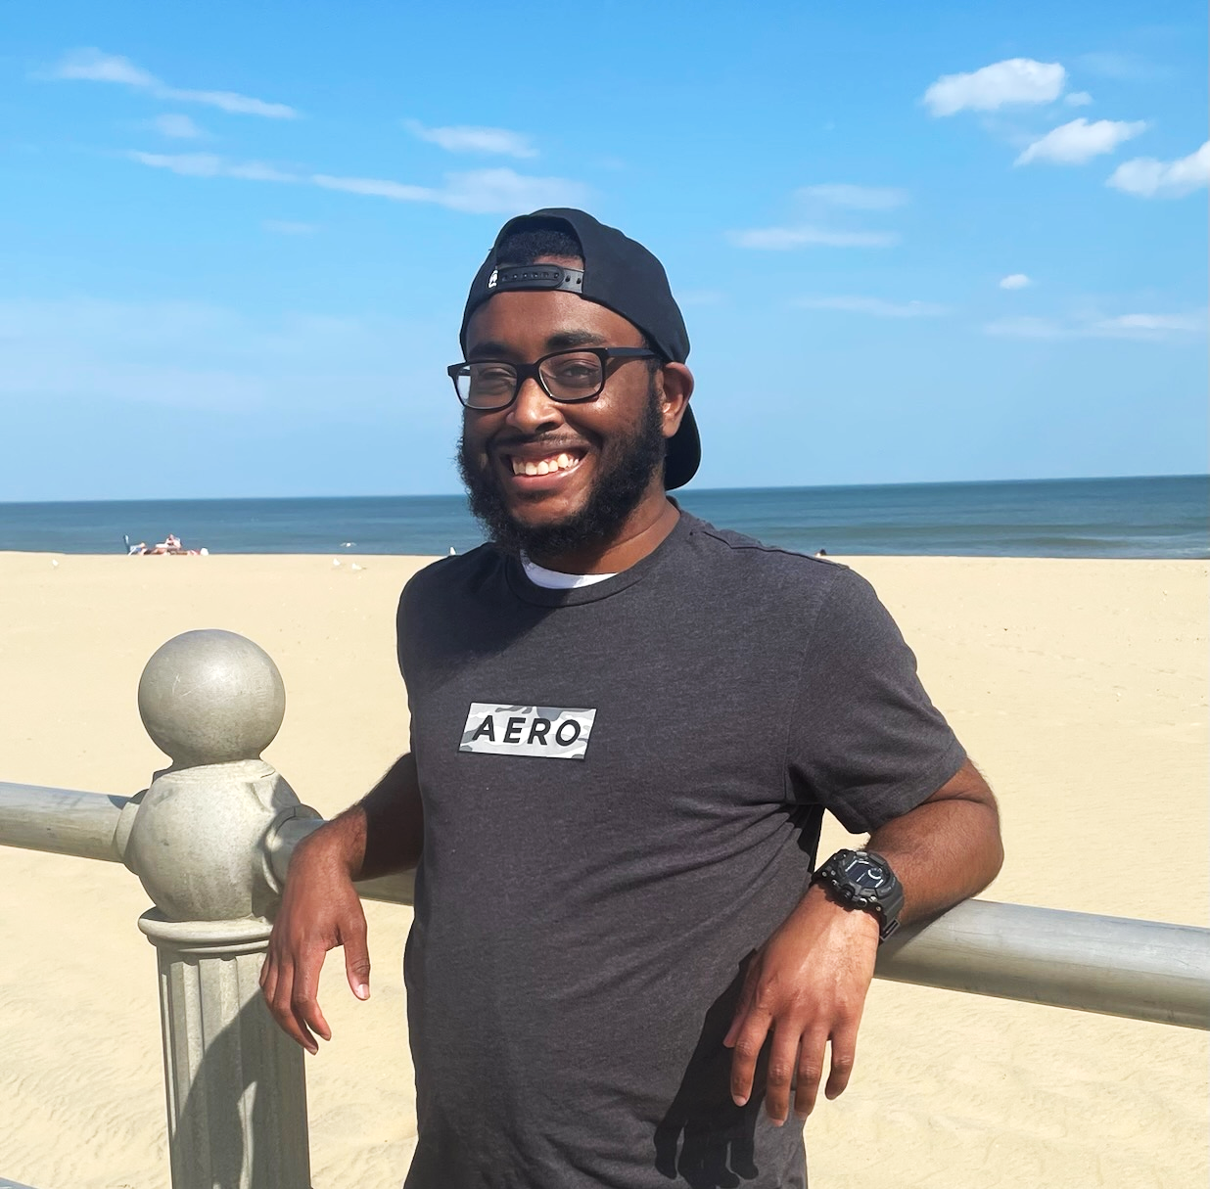
Biographies cont.
Alysha Morgan
Nolan Marchione
Devan Hill
Alysha is a undergraduate Senior at Old Dominion University, currently working towards her Bachelor’s degree in Computer Science with a minor in Cybersecurity. With a deep passion for technology, she is actively honing her skills to become a software engineer.
Nolan is an undergraduate senior at Old Dominion University, aiming for a Bachelor’s degree in Computer Science. He enjoys listening to music, and is interested in using his skills to develop video games and open-source software tools.
Devan is an undergraduate senior at Old Dominion University for a Bachelor’s degree in Computer Science. He enjoys learning different kinds of technology. He wants to write programs and develop video games.
CS 410
ReasonED.io | Feasibility
Notes:
[Each member will briefly introduce themselves]

Slide 5

Terms
Confirmation Bias - A cognitive bias that involves seeking, interpreting, and remembering information that confirms one’s preconceptions (American Psychological Association n.d.).
Critical Thinking - The ability to think clearly and rationally, understanding the logical connection between ideas and the ability to make reasoned judgements (American Psychological Association n.d.).
Fact-Checking - The process of verifying the accuracy of claims made in public discourse and journalism (Cambridge English Dictionary n.d.).
False Dilemma - A fallacy that presents a limited set of options as the only possible choices when there may be other alternatives (Excelsior OWL n.d.).
Logical Fallacy - An error in reasoning or a flawed argument that can make an argument appear valid when it is not (Nikolopoulou, 2023).
CS 410
ReasonED.io | Feasibility
Notes:
As you explore our software, you’ll encounter these terms frequently, and mastering their meanings is key to becoming a informed consumer of digital content.
Let’s begin by introducing the glossary of important terms our software addresses:
Confirmation Bias
This is a cognitive bias that occurs when individuals seek, interpret, and remember information that aligns with their existing beliefs.
In our context, it’s an important concept because it relates to how people tend to consume information online, often gravitating toward sources that confirm their existing views.
Critical Thinking
Critical thinking is a fundamental skill that involves clear and rational thought. It’s the ability to understand the logical connections between ideas and make reasoned judgements.
In our software, we aim to enhance critical thinking skills, helping users identify logical fallacies and improve their overall decision-making abilities.
Fact-Checking
Fact-checking is the process of verifying the accuracy of claims made in public discourse and journalism.
It’s a crucial part of our software’s mission, as it empowers users to know the difference between accurate and false information by providing them with the tools to fact-check claims effectively.
False Dilemma
A false dilemma is a logical fallacy that presents a limited set of options as the only possible choices when other alternatives may exist.
Logical Fallacy
This term refers to errors in reasoning or flawed arguments that can make an argument seem valid when it is not. In the context of our software, understanding logical fallacies is crucial for users to discern between sound and unsound arguments.

Slide 6
Terms
cont.
Misinformation - False or inaccurate information shared, often unintentionally, without the intent to deceive (Dictionary.com n.d.).
Disinformation - False information deliberately spread to deceive or mislead others (Dictionary.com n.d.).
Slippery Slope - A fallacy that suggests one small step will inevitably lead to a chain of related events, often with exaggerated consequences (Excelsior OWL n.d.).
Straw Man Argument - A fallacy that involves misrepresenting an opponent’s argument to make it easier to attack and refute (Excelsior OWL n.d.).
CS 410
ReasonED.io | Feasibility
Notes:
Misinformation
False or inaccurate information shared without the intent to deceive.
Disinformation
False information deliberately spread to deceive or mislead others.
Slippery Slope
A fallacy that suggests one small step will inevitably lead to a chain of related events, often with exaggerated consequences.
Straw Man Argument
This fallacy involves misrepresenting an opponent’s argument to make it easier to attack and refute.
So, with our building blocks out of the way we can continue on with our background.

Slide 7

Background
In the digital age, the ubiquity of the Internet has transformed the way we access, consume, and interact with information.
The online world serves as an expansive repository of knowledge, but it is not immune to misinformation and flawed reasoning (Wardle and Derakhshan, 2017).
CS 410
ReasonED.io | Feasibility
Notes:
In this digital era, the Internet has become an essential tool for accessing and engaging with an immense pool of information.
And, it has transformed the way we acquire knowledge, interact with content, and participate in online discussions.
However, this vast online landscape is not immune to problems, and one of the key issues we face is the prevalence of logical fallacies.
In 2017, researchers from the council of europe discovered how misinformation and flawed reasoning is perpetuated by logical fallacies
And they often lead to real-life consequences in social, health, or political fields.

Slide 8

Background cont.
Logical fallacies, such as straw man arguments, false dilemmas, slippery slopes, and others, persist in online content, undermining the quality of discussions and the credibility of information distribution.
Fallacy
From the latin root fallac, which means to deceive (Etymology n.d.).
CS 410
ReasonED.io | Feasibility
Notes:
These fallacies come in various forms, including strawman arguments, false dilemmas, slippery slopes, and many others.
They are deceptive tactics used within arguments to manipulate the structure of reasoning.
Fallacies diminish the quality of discussions and raises doubts about the credibility of information shared online.
Whether if it's through articles, podcasts, and the like.
Unlike blatant false information, which can be fact-checked and addressed directly, fallacies are often well-disguised within seemingly plausible arguments, making them difficult to discern.
And as we’ll explore in the next slide, they aren’t always easy to spot.

Slide 9
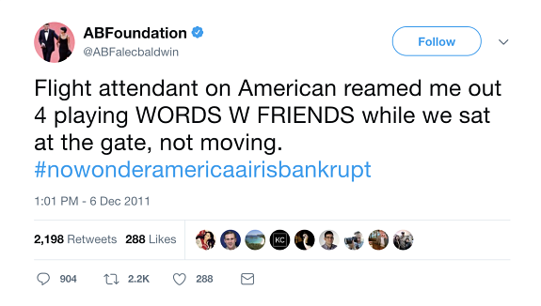

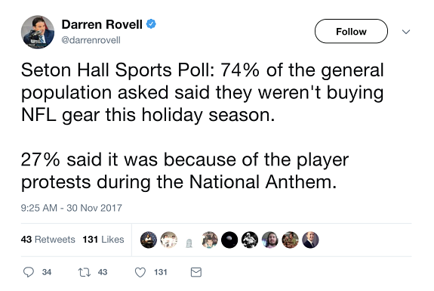
Background - Examples
1
3
In a blog post by M. Hope Echales (2017), the author discusses various Twitter posts related to LSAT preparation. @ABFalecbaldwin, @darrenrovell, and @bobatl, were all topics of the discussion.
2
CS 410
ReasonED.io | Feasibility
Notes:
Twitter images from -> https://blog.blueprintprep.com/lsat/identifying-flaws-in-your-twitter-feed-a-new-frontier-in-lsat-preparation/
Here, three different Twitter posts serve as examples of logical fallacies often encountered online that we would not initially think harmful.
1st Post – Causation Fallacy (Post Hoc, Ergo Propter Hoc)
This post illustrates a causation fallacy, specifically known as “post hoc, ergo propter hoc”, which means “after this, therefore because of this.”
It’s when someone assumes that because one event followed another, the first event caused the second, in the absence of logical evidence.
In this case, the post is suggesting a connection between playing Words with Friends at the gate and the financial struggles of American Airlines, although there is no logical basis for such a claim.
2nd Post – Sampling Fallacy
In this post, we encounter a sampling fallacy, which arises when the studied sample does not accurately represent the entire population, leading to potentially inaccurate results.
In this case, the statement claims that 74% of the general population is not buying NFL gear this holiday season, meaning that it implies that the remaining 26% are considering such purchases. However, this assumption may not hold true for the entire population as it depends on…
1. How the sample was selected
2. Whether it accurately represents the opinions of the entire population.
3rd Post – Absence of Evidence Fallacy
This post represents an absence of evidence fallacy. This person is suggesting that if the visible cities in the background don’t show the Earth’s curvature, then the Earth must be flat.
One piece of evidence, or the lack thereof, does not conclusively prove or disprove a claim, like whether the Earth is round or flat.
Now, Dakota will discuss some statistics related to our problem.

Slide 10
Statistics
86% of 4th-grade teachers expressed a substantial emphasis on deductive reasoning (Bouygues, 2022).
86
The above figure dwindled to a mere 39% among 8th-grade teachers when expressing the same sentiment (Bouygues, 2022).
39
50% of teachers indicated that they face challenges in allocating time to teach critical thinking skills effectively (Critical Thinking Teacher Survey 2019).
50
Just 21% of teachers agreed that they possess all the necessary resources to cultivate these skills (Critical Thinking Teacher Survey 2019).
21
CS 410
ReasonED.io | Feasibility
Notes:
Resources:
https://nces.ed.gov/nationsreportcard/about/
https://www.forbes.com/sites/helenleebouygues/2022/08/17/critical-skills-not-emphasized-by-most-middle-school-teachers/?sh=4a0a97452ee4
https://reboot-foundation.org/wp-content/uploads/2022/07/Reboot-White-Paper_NAEP-5.pdf
https://www.cambridge.org/us/cambridgeenglish/catalog/skills/unlock-2nd-edition/product-details/teaching-critical-thinking?utm_source=wobl&utm_medium=blog&utm_content=woblcontent&utm_campaign=unlock
Next Speaker: Nolan
In this slide, we aim to connect the significance of students having low critical thinking skills to their ability to identify logical fallacies.
According to a recent report titled “Teaching Critical Thinking in K-12” there are inconsistencies in the instruction of critical thinking across the U.S.
What’s noteworthy is that these inconsistencies tend to worsen as students progress through their academic journey as we can see with our first two figures.
Among 4th-grade teachers, 86% emphasized on teaching deductive reasoning, which sounds good.
But this figure sharply declines to a mere 39% among 8th-grade teachers when expressing the same sentiment.
So, there is clearly a decline in the emphasis on critical thinking in our education system.
Moreover, a 2019 global survey conducted by Cambridge revealed challenges faced by educators in teaching critical thinking.
50% of teachers indicated they do not have enough time to effectively teach these skills.
Even more concerning is the fact that only 21% of teachers agreed that they possess all the necessary resources to cultivate these skills.
As a result, educators often find themselves unable to effectively teach deductive reasoning among students. This deficiency impairs k-12 students and their capacity to identify logical fallacies accurately, which leads us to our problem statement by Nolan.

Slide 11
Problem
Statement
High school graduates are not prepared with the skills necessary to identify logical fallacies in an increasingly online world.
CS 410
ReasonED.io | Feasibility
Notes:
Late Introduction: Firstly, students don’t encounter logical fallacies until at least middle school, but often not until high school. This means that they’re introduced to these crucial concepts relatively late in their education.
Brief Coverage: Even when students do encounter logical fallacies, it’s typically only a quick topic in Language Arts or English classes. This limited exposure doesn’t provide them with a comprehensive understanding that they can apply in the real world.
Forgetfulness: It’s a common occurrence that students tend to forget most of what they learn about logical fallacies after the lesson is over, highlighting a need for ongoing reinforcement.
Identification Challenges: As teens and adults, many individuals struggle to identify flawed logic in others’ reasoning as well as in their own arguments. This inability can hinder effective critical thinking.
Internet Misinterpretation: On the internet, especially in the realm of social media, teens and adults often mistake flawed logic for sound reasoning (something that sounds good). This can lead to the spread of misinformation and misconceptions.
Rapid Dissemination: Notably, reasoning that contains logical fallacies gets repeated and shared rapidly via social media platforms, contributing to the perpetuation of flawed arguments.
Impact on Discussions: Ultimately, this reliance on flawed reasoning effects discussions both online and in-person, making it challenging to have informed and productive conversations about various issues.

Slide 12


Problem
Characteristics
Prevalence of Logical Fallacies
Limited Critical Thinking Skills
Misinformation Vulnerabilities
Neglecting Contextual Research
CS 410
ReasonED.io | Feasibility
Notes:
Prevalence of Logical Fallacies
Wide Range of Platforms: Logical fallacies are widespread on various online platforms, including social media, news websites, forms, and blogs. They cannot be eliminated.
Recognizing this prevalence is the first step in underscoring the urgency of improving users’ ability to identify and address these issues, ultimately fostering critical thinking and informed discourse.
Limited Critical Thinking Skills (relating to our statistics)
Lack of Formal Education: High school graduates lack formal education on logical fallacies.
Online Learning Impact: The shift toward online education, especially during the COVID-19 pandemic, has highlighted the deficiency in these skills.
Real-Life Consequences: Graduates’ struggles to evaluate arguments in real-world situations affect their decision-making processes in various life aspects, including personal relationships and career choices.
Misinformation Vulnerabilities (emphasize that their inability to identify logical fallacies can perpetuate myths and misconceptions)
Graduates’ vulnerability to misinformation not only affects them individually but also contributes to the broader issue of false information spreading across the internet.
This misinformation can lead to social, political, and health consequences as individuals who cannot identify logical fallacies may be more susceptible to biased content or make decisions that jeopardize their well-being.
Neglecting Contextual Research
Users often overlook the importance of conducting in-depth contextual research when encountering online information containing logical fallacies.
Failure to delve into the background, source, or context of information can result in the perpetuation of flawed arguments.
Neglecting contextual research contributes to the persistence of logical fallacies, as users may accept information at face value without questioning its validity.
Educating users about the significance of contextual research can mitigate the impact of logical fallacies and enhance their ability to identify flawed reasoning in online content.
I’ll hand it over to June, who will explain the Current Process Flow..

Slide 13
Current Process Flow
Does existing curriculum provide resources?
Are resources reusable over the course of year?
Are there similar resources to support each grade level?
K-12 educator in need of resources to better teach about logical fallacies
Yes
Yes
No
No
No
Yes
No
Teacher has time/tools to create/find their own resources?
Are they
readily accessible?
Teacher Prepares resource for class
Students forget material/ Don’t develop skills
Yes
No
Yes
Resources won’t get used enough
Students can effectively apply fallacy identification skills
= Initial State
= Final State
CS 410
ReasonED.io | Feasibility
Notes:
Instructors looking to teach logical fallacy detection skills currently face a number of challenges. First they must check existing curriculum to see if it provides resources to teach these skills. If not, they have to spend time ether creating their own materials from scratch or searching through a variety of sources to have the tools they need. Regardless of the source of the materials, there are still a number of challenges to students developing effective fallacy identification skills. If the resources are not reusable over the course of the year, students will not develop adequate skills. If there are not similar resources across grade levels, students will forget material and fail to build on the skills they have acquired. If the materials are not easy to access and use, students will be exposed to the material infrequently will not fully develop fallacy detection skills. Only if all of these elements come together will students be fully supported to build their skills in logical fallacy detection.
Emily Solution
Let’s break down the current process flow into a more structured narrative to better understand the journey of a K-12 educator in need of logical fallacy teaching resources:
Start State (Step 1): Our journey begins with a K-12 educator recognizing the importance of teaching logical fallacies in their curriculum. They seek resources to enhance their teaching in this domain.
Existing Curriculum (Step 2): The educator’s first checkpoint involves assessing their existing curriculum. Do they already have resources for teaching logical fallacies?
If yes, they proceed to integrate these resources into their teaching in Step 3.
If no, they move to Step 4.
Resource Reusability (Step 3): At this juncture, the educator evaluates the reusability of the resources at hand. Can these resources effectively serve their teaching needs throughout the academic year?
If yes, the resources are versatile and they continue to Step 6.
If no, they face a challenge, prompting them to find their own resources in Step 7.
Resource Creation (Step 4): If the educator has the time and tools to create or find their own resources, they venture into preparing these materials for classroom use in Step 5.
If no, they return to Step 1, restarting the loop.
Resource Preparation (Step 5): Here the teacher invests time and effort in preparing the resources for their class, subsequently lopping back to assess resource reusability in Step 3.
Grade-Level Resources (Step 6): When resources are available, the educator considers whether there are similar resources suitable for different grade levels.
If yes, they adopt them to cater to various grades and proceed to Step 8.
If not, they face challenges in adapting resources for different levels in Step 7.
Student Outcomes (Step 7): If students fail to retain the material or develop the required skills, the educator faces the need to revisiting their teaching resources and methods, initiating the loop to Step 1.
Accessibility and Usability (Step 8): In this step, educators examine whether the resources are easily accessible and user-friendly.
If they are, they proceed to Step 9, where the ultimate goal is achieved.
If not, they encounter difficulties in resource implementation in Step 10.
End State (Step 9): Successful implementation of accessible and user-friendly resources leads to students effectively applying their fallacy identification skills, which is the desired outcome.
Resource Usage (Step 10): In the final step, educators confront the possibility that resources may not get used as intended due to accessibility or usability issues. This situation propts them to revisit the initial challenge in Step 1.

Slide 14

ReasonED is a game-based learning website that improves the ability of users to identify logical fallacies through simple, age-appropriate games. This website will provide educators with a tool to cultivate their student’s critical reasoning skills over the long-term and beyond the scope of a single subject.
Re sonED
CS 410
ReasonED.io | Feasibility
Notes:
So specifically, what we’re looking at for the real-world product is a website that hosts an elementary school collection of games, a middle school collection of games, high school collection of games, and adult collection of games, respectively. They’ll all share the same goal of introducing and improving logical fallacy identification skills, but the difficulties and approaches will vary depending on the age group. Because our solution is a website, once it’s whitelisted on school networks, students can access it in their free-time during school and really get the chance to have fun with it. Given how schools are pushing to incorporate more technology into lessons, a website like ours has potential to gain a lot of exposure even outside of language arts classes.

Slide 15
Features
ReasonED WILL contain:
Simple, school-friendly 2D games to be played directly on the site
Wide range of game difficulties
Instructions for each game
Introductory readings for each age group
ReasonED will NOT contain:
RAM and CPU-intensive elements
Lesson plans (unless provided by educators)
In-game references to specific people or political events
CS 410
ReasonED.io | Feasibility
Notes:
To make the scope of our solution more clear, I’ll break down some of the features that it will have and won’t have.
-ReasonED will contain 2D games that will be playable directly on the website, so logging in or downloading will not be necessary to play them. Players will only need to sign up to be eligible for leaderboards, but signing up will be completely free.
-We WILL have a wide range of game difficulties for elementary, middle, high school students, and adults respectively. Having a big collection of games available across such a large segment of the educational spectrum is very crucial to our problem because, as you saw from the current process flow, most existing resources fall short of supporting year-long learning, much less supporting continuous learning over all of the grade levels.
-We WILL include In-game tutorials for each of our games, and all of the text in the games will have text-to-speech options for better accessibility, especially for younger players who can’t read well yet.
-Lastly, our website will have readings to help introduce the concept of logical fallacies to each individual age group. The idea behind this is to provide some brief background knowledge to users in case they aren't accessing the site for a school lesson, because one goal of the site is being playable outside of the classroom. These readings will have text-to-speech options as well.
Some features ReasonED WILL NOT have are:
-Game and website elements that are too intensive. Browsers alone can use a lot of RAM, and not every school or household can afford high-end devices. So we want the site to be relatively fast, not be cluttered, and we want to keep the games lightweight enough to be playable even on lower-end devices.
- We won’t be developing lesson plans. We’d love to be able to include them for teachers since those are great educational tools, but our main priority will be the games. With that said though, we could absolutely host resources like that if they're provided to us.
-Lastly, ReasonED won’t contain references to specific people or political events. This can become a fine line to walk when we're developing the gameplay for older players, since we'll want examples in the games to more applicable to the real world, and in the real world logical fallacies are seen very often in politics. Ultimately though, we want to avoid referencing political arguments. We don't want the site to contain any political bias, especially since a goal of ours is for it to be used in schools.
Now I’ll pass it off to Areeb to discuss our customers and end users.

Slide 16

Customers & End Users
Customers:
K-12 schools
Colleges
Universities
Educational publishers
End Users:
K-12 Students (including homeschoolers)
College Students
Educators
General Public
CS 410
ReasonED.io | Feasibility
Notes:
Our primary customers are educational institutions, including K-12 schools, colleges, and universities. These institutions are at the forefront of education, and ReasonED can serve as a valuable resource in their curriculum and foster critical thinking skills among students.
Additionally, we extend our reach to educational publishers and content providers. They can explore adopting ReasonED as a tool to complement their existing offerings, providing an enriched learning experience for their audience.
Now let’s talk about the end users who will directly benefit from this platform.
K-12 Students (including homeschoolers): These young minds are our core audience. ReasonED aims to empower them with improved critical thinking skills through engaging games and educational content.
College Students: We are extending our reach to include college-level students. The transition to higher education presents new challenges and ReasonED can continue to support critical thinking development at this level.
Educators: Instructors (both k-12 teachers and professors) play a pivotal role in guiding students’ learning journeys. ReasonED can be a valuable tool for educators to incorporate into their teaching methods.
General Public: Beyond the classroom, critical thinking is a skill that holds value in various aspects of life. The general public can access ReasonED to enhance their ability to identify logical fallacies, ultimately contributing to more informed discussions both online and offline.
Now, June will go over the Solution Process Flow..

Slide 17
Solution Process Flow
Does existing curriculum provide resources?
Are resources reusable over the course of year?
Are there similar resources to support each grade level?
K-12 educator in need of resources to better teach about logical fallacies
Yes
Yes
No
No
No
Yes
Are they
readily accessible?
Teacher Finds Reason IO
No
Yes
Students use ReasonIO to practice skills
Students can effectively apply fallacy identification skills
= Initial State
= Final State
CS 410
ReasonED.io | Feasibility
Notes:
ReasonED.io will be the resource instructors need to support effective logical fallacy detection instruction. If the existing curriculum does not provide resources, ReasonED will provide instructional resources. If existing resources are not reusable, ReasonEd will be a reusable resource for logical fallacy detection. If existing resources do not support multiple grade levels, ReasonED will provide increasing challenges as students grow. And if existing resources are not easy to access or use, ReasonED.io will be available as an easy to set up and use option. By being an all-in-one solution to these problems, instructors will not have to spend time creating and searching for materials to teach logical fallacy skills and will be better able to support students as they master these skills.
Dakota Competition
ReasonED solves many of the problems in the current process. It eliminates most of the extra work and pitfalls educators face when attempting to provide logical fallacy instruction. It provides prebuilt resources to reinforce logical fallacy detection that are easily accessible and reusable both over the year and at different grade levels. By having consistent practice throughout their education, students will develop effective skills in detecting logical fallacies.

Slide 18
Competition Matrix
Direct Competitors
 | ReasonED.io | ABCya! | Funbrain | Arcademics | BrainPOP
Primary Audience | K-12 and Adult | Pre-K - 6 | Pre-K - 8 | K-8 | K-8
Game-Based Learning | ✓ | ✓ | ✓ | ✓ | ✓
Logical Fallacy Focus | ✓
Device Compatibility | PC, Tablet | PC | PC | PC | PC
Characters and Animation for Kids | ✓ | ✓ | ✓ |  | ✓
Accessibility Features | ✓
Educator Tools | ✓ | Premium Only |  | Premium Only | ✓
Easily Playable outside of School? | ✓ | ✓ | ✓ | ✓ | ✓
Cost | Freemium | Freemium |  | Freemium
CS 410
ReasonED.io | Feasibility
Notes:
Next Speaker: Alysha
Who are our competitors?
Kahoot! - An interactive learning platform that allows educators to create and hosts quizzes, surveys, and interactive games in a classroom or remote learning environment.
Engages students though competitive and engaging quiz-based activities
Users can participate using a mobile device or computer
Quizlet Live - A new feature of the popular learning platform that allows educators to host flashcard games live, similar to Kahoot
Users can create their own study materials or access a vast library of user-generated content
Offers a range of study modes and interactive games
Socrative - An assessment and engagement platform for teachers and students.
Educators can create quizzes, surveys, and quick assessments to gauge student understanding and engagement
Allows real-time feedback and reporting, making it useful for both in-class and remote learning environments
GimKit - An educational game-based platform designed to make learning fun and engaging.
Offers interactive quizzes and games where students earn virtual currency to upgrade their avatars and compete with classmates
Teachers can create and customize content
Factors to discuss
Primary audience - Specifies the main target audience or user base of the platform.
Game-Based Learning - Indicates whether the platform is known for game-based learning experiences, where users can engage with educational content through interactive games.
Logical Fallacy Focus - Specifies if the platform has a specific focus on teaching and identifying logical fallacies in arguments. Our website focusing solely on logical fallacies is beneficial for spreading awareness about the problem at hand. If logical fallacy games were to just be added to existing, all-subject game sites, they would likely get lost in the sea of other games, and we're back at square one. Having their own site serves to give logical fallacy concepts the undivided attention they've been lacking.
Device Compatibility - Specifies what device can be used to access the platform.
Characters and Animations - specifies whether the competitor’s games emphasize engaging features specifically for younger kids
Educator Tools - Indicates whether the platform provides tools and features provided for educators, like class management, progress tracking, or assignment creation.
Accessibility - Refers to how easily and effectively users with different needs, including those with disabilities, can interact with and use the platform. This can include features such as text-to-speech for visually impaired users, keyboard navigation options, adjustable font sizes, and compatibility with screen users.
Playability outside of school- Indicates whether or not the games are just as accessible for users if not used at school, for instance, without a game code. Many of our competitor’s sites don’t have accessible games aside from their live game mode for in-school use.
Cost - Specifies the pricing model of the platform, whether it’s subscription-based, freemium (offering free and premium versions, or other pricing structures. Premium features: Progress Tracking, All games frees
When discussing accessibility
Kahoot!
Keyboard Navigation (without a mouse)
Screen Reader Support (for users with visual impairments)
Color Contrast (for users with visual impairments)
Text-To-Speech (for users with visual impairments and reading difficulties)
Closed Captioning (for users with hearing impairments)
Quizlet
Keyboard Navigation
Screen Reader Support
Color Contrast
Keyboard Shortcuts
Text-To-Speech
Closed Captioning
Socrative
Keyboard Navigation
Screen Reader Support
Adjustable Font Sizes (for users with visual impairments)
Color Contrast
Closed Captioning
Responsive Design (features work on various devices)
GimKit
Keyboard Navigation
Color Customization
Responsive Design
Text-To-Speech (for users with visual impairments and reading difficulties)

Slide 19
Competition Matrix
Indirect Competitors
 | ReasonED.io | Kahoot! | Quizlet Live | Socrative | Gimkit
Primary Audience | K-12 and College | K-12 and College | K-12 and College | K-12 | K-12
Game-Based Learning | ✓ | ✓ | ✓ |  | ✓
Logical Fallacy Focus | ✓
Device Compatibility | PC, Tablet | PC, Phone | PC, Phone | PC, Phone | PC, Phone
Characters and Animation for Kids | ✓ | Depends on Game |  |  | Depends on Game
Accessibility Features | ✓ | ✓ | ✓ | ✓ | ✓
Educator Tools | ✓ | ✓ | ✓ | ✓ | ✓
Easily Playable outside of School? | ✓
Cost | Freemium | Freemium | Freemium | Freemium | Subscription
CS 410
ReasonED.io | Feasibility
Notes:
Who are our competitors?
Kahoot! - An interactive learning platform that allows educators to create and hosts quizzes, surveys, and interactive games in a classroom or remote learning environment.
Engages students though competitive and engaging quiz-based activities
Users can participate using a mobile device or computer
Quizlet Live - A new feature of the popular learning platform that allows educators to host flashcard games live, similar to Kahoot
Users can create their own study materials or access a vast library of user-generated content
Offers a range of study modes and interactive games
Socrative - An assessment and engagement platform for teachers and students.
Educators can create quizzes, surveys, and quick assessments to gauge student understanding and engagement
Allows real-time feedback and reporting, making it useful for both in-class and remote learning environments
GimKit - An educational game-based platform designed to make learning fun and engaging.
Offers interactive quizzes and games where students earn virtual currency to upgrade their avatars and compete with classmates
Teachers can create and customize content
Factors to discuss
Primary audience - Specifies the main target audience or user base of the platform.
Game-Based Learning - Indicates whether the platform is known for game-based learning experiences, where users can engage with educational content through interactive games.
Logical Fallacy Focus - Specifies if the platform has a specific focus on teaching and identifying logical fallacies in arguments.. Our website focusing solely on logical fallacies is beneficial for spreading awareness about the problem at hand. If logical fallacy games were to just be added to existing, all-subject game sites, they would likely get lost in the sea of other games, and we're back at square one. Having their own site serves to give logical fallacy concepts the undivided attention they've been lacking.
Device Compatibility - Specifies what device can be used to access the platform.
Characters and Animations - specifies whether the competitor’s games emphasize engaging features specifically for younger kids
Educator Tools - Indicates whether the platform provides tools and features provided for educators, like class management, progress tracking, or assignment creation.
Accessibility - Refers to how easily and effectively users with different needs, including those with disabilities, can interact with and use the platform. This can include features such as text-to-speech for visually impaired users, keyboard navigation options, adjustable font sizes, and compatibility with screen users.
Playability outside of school- Indicates whether or not the games are just as accessible for users if not used at school, for instance, without a game code. Many of our competitor’s sites don’t have accessible games aside from their live game mode for in-school use.
Cost - Specifies the pricing model of the platform, whether it’s subscription-based, freemium (offering free and premium versions, or other pricing structures.
When discussing accessibility
Kahoot!
Keyboard Navigation (without a mouse)
Screen Reader Support (for users with visual impairments)
Color Contrast (for users with visual impairments)
Text-To-Speech (for users with visual impairments and reading difficulties)
Closed Captioning (for users with hearing impairments)
Quizlet
Keyboard Navigation
Screen Reader Support
Color Contrast
Keyboard Shortcuts
Text-To-Speech
Closed Captioning
Socrative
Keyboard Navigation
Screen Reader Support
Adjustable Font Sizes (for users with visual impairments)
Color Contrast
Closed Captioning
Responsive Design (features work on various devices)
GimKit
Keyboard Navigation
Color Customization
Responsive Design
Text-To-Speech (for users with visual impairments and reading difficulties)
Alysha will now talk about our technical risks.

Slide 20
Technical Risks
Impact
T1: Version Compatibility
Risk: Compatibility issues with varying browsers.
M1: Keep up with browser updates and maintain backward compatibility.
T2: Third-Party Integrations
Risk: Problems with integrating external services or APIs.
M2: Careful selection and testing of third-party tools or APIs.
T3: Data Backup and Recovery
Risk: Risks of data loss or system failure.
M3: Implement regular data backup and recovery procedures.
Impact
 | Very Low | Low | Medium | High | Very High
Very High
High
Medium |  |  | T1 | M3 | T3
Low |  | M1 | M2 | T2
Very Low
Likelihood
CS 410
ReasonED.io | Feasibility
Notes:
Here, we will dissect the challenges faced both pre-mitigation and the strategic steps taken post-mitigation to fortify our educational platform.
Version Compatibility
Pre-Mitigation:
First on the list, we recognized that version compatibility issues held a medium impact on our software.
The risk stemmed from the diversity in browser versions, potentially disrupting the user experience.
For the experience, imagine users facing slow loading times or features not working as intended due to outdated compatibility.
The likelihood was also medium, given the routine nature of browser updates, each carrying the potential to affect our application’s performance.
Without careful maintenance and updates, the risk of these issues arising is significant.
Post-Mitigation:
For Post-Mitigation, we’ve implemented a robust version control and testing process.
Regular compatibility checks with different browser versions are now standard procedure.
Proactively identifying and addressing compatibility concerns has reduced the impact on the user experience.
We’ve also established a responsive support system to swiftly address user concerns.
Our goal is simple: minimal disruption and user dissatisfaction, especially when those inevitable browser updates are released.
Third-Party Integrations
Pre-Mitigation:
Moving on to another critical area - the risk associated with third-party integrations.
Our assessment revealed a high pre-mitigation impact.
Issues with external services or APIs could significantly disrupt our application’s functionality.
The likelihood, though low, hinged on the selection and testing of third-party tools or APIs.
Hasty or poorly-tested integrations could increase the likelihood of problems, posing a potential threat.
Post-Mitigation
So, our post-mitigation strategy is to perform thorough research and testing before integrating any external services.
This involves a comprehensive testing process for third-party tools to ensure reliability and suitability for our software.
By doing so, we’ve effectively reduced the impact of integration issues on our application’s functionality.
Regular audits and monitoring of our integrated services are now in place, ensuring a high level of reliability remains our top priority.
Data Backup and Recovery
Pre-Mitigation
Lastly, let’s explore the risk of data loss and system failure.
Pre-mitigation, we recognized this risk as the highest impact.
System failure can lead to extended downtime, disrupting user access and causing a loss of trust.
The likelihood, although medium, underscored the importance of regular backup and recovery procedures.
Without these measures, the risk of data loss ir system failure remained moderately likely.
Post-Mitigation.
To tackle this, we’ve implemented a robust backup and recovery system.
Regular and automated backups ensure that critical user data, such as personal addresses and passwords, is protected and can be swiftly restored in the event of a data loss or system failure.
This reduces the impact on users and mitigates potential trust loss.
System health monitoring and maintenance, including regular checks and data integrity assessment, further help identify and address issues before they escalate.
I’ll hand it over to Nolan to discuss the customer and security risks.

Slide 21
Customer Risks
Impact
C1: User Proficiency
Risk: Users may not have the prerequisite knowledge or skills to benefit from the application.
M1: Tutorials and introductory lessons help lower the bar for new users.
C2: User Engagement
Risk: Customers may not feel the need to stay engaged with the games.
M2: Progress tracking and regular content updates help to maintain user interest.
C3: User Feedback
Risk: If a game is too difficult or is not explained well, then users might stop using the application.
M3: Provide feedback mechanisms to iterate on the game.
 | Very Low | Low | Medium | High | Very High
Very High
High |  |  |  | C2
Medium |  |  |  | C1
Low |  |  | C3 | M2
Very Low |  |  | M3 | M1
Likelihood
CS 410
ReasonED.io | Feasibility
Notes:
User Proficiency:
Pre-Mitigation:
We identified that the impact of the risk is high, and the likelihood is also high.
Some users may not have the prerequisite knowledge or skills to benefit from our application.
Post-Mitigation:
We’ve introduced introductory lessons to lower the bar for new users.
Additionally, the likelihood of this risk occuring has been reduced, as these resources guide users through the learning process, making it more accessible.
User Engagement:
Pre-Mitigation:
We assessed that the impact of this risk is high, and the likelihood is medium.
Some customers may not feel the need to stay engaged with our games.
Post-Mitigation:
We’re tracking user progress and providing regular content updates to maintain user interest.
This approach reduces the impact by ensuring content to interact with.
Moreover, by tracking user progress, we can tailor their experience, enhancing engagement.
The likelihood of this risk has been lowered through these strategies.
User Feedback:
Pre-Mitigation:
We recognized that the impact of this risk is medium, and the likelihood is low.
Some users might discontinue using our application due to game difficulty or poor explanations.
Post-Mitigation
We provide feedback mechanisms to gather user feedback and iterate on the game.
This approach reduces the impact by allowing us to make necessary improvements based on user feedback.
The likelihood of this risk has been further decreased as we actively engage with our users, ensuring that their concerns are addressed promptly and enhancing the overall user experience.

Slide 22
Security Risks
Impact
S1: Data Security
Risk: Users may be concerned about what data is collected on them.
M1: Communicate what data is gathered, and comply with data protection regulations to keep collected data safe.
S2: Account Security
Risk: Unauthorized access to a user account.
M2: Strong password policies and two-factor authorization for account login.
S3: Security Updates
Risk: New exploits are discovered which jeopardize our systems.
M3: A regular schedule for checking for exploits and implementing security patches.
 | Very Low | Low | Medium | High | Very High
Very High
High |  |  |  | S2
Medium |  |  | S1 |  | S3
Low
Very Low |  | M1 | M2 | M3
Likelihood
CS 410
ReasonED.io | Feasibility
Notes:
Data Security:
Pre-Mitigation:
We identified that the impact of this risk is medium, and the likelihood is also medium.
Some users may have concerns about what data is collected on them (in particular, sensitive information including names and addresses).
Post-Mitigation:
We communicate transparently about what data is gathered and ensure that we comply with data protection regulations to keep collected data safe.
This approach reduces the impact by building trust through transparency.
Additionally, the likelihood of this risk occurring is reduced as users are informed and reassured about their data privacy.
Account Security:
Pre-Mitigation:
We assessed that the impact of this risk is high, and the likelihood is also high.
Unauthorized access to a user account is a significant concern.
Post-Mitigation:
We’ve implemented strong password policies and two-factor authorization for account login.
This approach reduces the impact by enhancing the security of user accounts.
Moreover, the likelihood of this risk occurring has been reduced by the implementation of these security measures.
Security Updates:
Pre-Mitigation:
We recognized that the impact of this risk is very high, and the likelihood is medium.
New exploits are discovered which could jeopardize our systems.
Post-Mitigation:
We maintain a regular schedule for checking and implementing security patches.
This approach reduces the impact by ensuring that our systems are up-to-date and secure.
The likelihood of this risk has been further decreased through proactive security patch management.
Now Emily will go over the Major Functional Components Diagram.

Slide 23
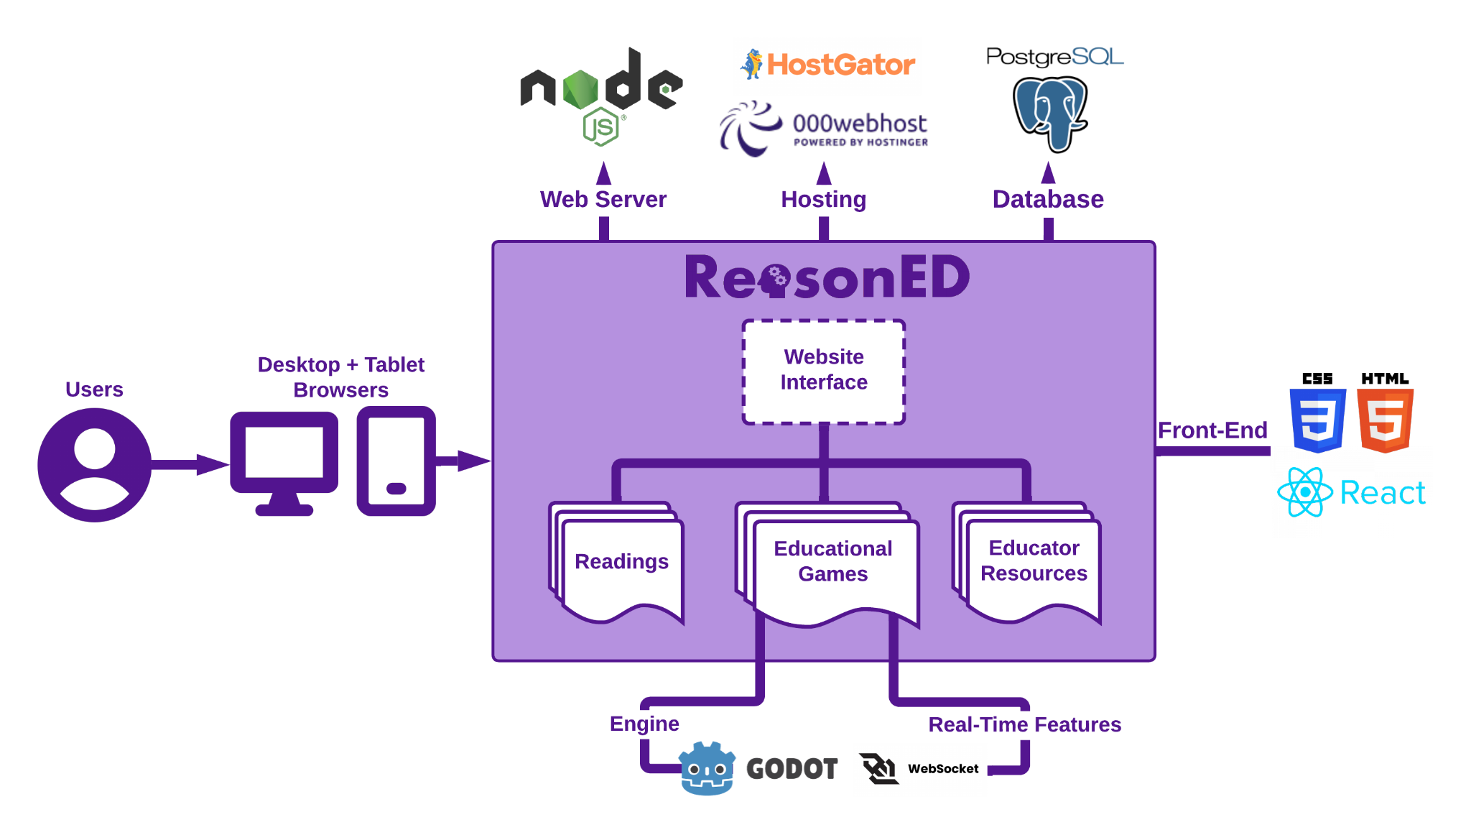

MFCD
GDScript
CS 410
ReasonED.io | Feasibility
Notes:
Users will interact with Reason.io through Desktop and Tablet browsers. The website's frontend will be developed using HTML5, CSS 3, and React for dynamic elements. The primary component of our site is the collection of games. These will be developed using Godot, with C# and GDScript as our languages. Any real-time features such as leaderboards will be implemented with Websocket. Websocket will be connected to a Node.js web server, and any leaderboard data or data for signed-up users will be stored in a PostgreSQL database. We haven’t finalized a hosting service yet, but both HostGator and webhost are services we would consider for the scope of the real world product. Conclusion is next

Slide 24
Conclusion
Nationwide lack of logical fallacy identification skills
Our games and resources will strengthen those skills
Prioritize critical reasoning in U.S. schools at all grade levels
Questions? Comments?
CS 410
ReasonED.io | Feasibility
Notes:
To reflect on the problem:
- High school graduates in the U.S. have a serious lack of logical fallacy identification skills.
- Our solution, ReasonED, will be a game-based learning website that allows students to build those skills continuously from Elementary school up through high school and beyond.
- When built, ReasonED could have the potential to transform how U.S schools approach teaching logical fallacies. With the help of our resources for long-term learning, this aspect of critical reasoning can come to the forefront of k-12 Language Arts education rather than being an afterthought.
That concludes the presentation, thank you so much for listening, and now we'll take take any questions and comments that you have.

Slide 25
References
American Psychological Association. (n.d.). Apa Dictionary of Psychology. https://dictionary.apa.org/critical-thinking
American Psychological Association. (n.d.). Apa Dictionary of Psychology. American Psychological Association. https://dictionary.apa.org/confirmation-bias
Bouygues, H. L. (2022, June). Teaching Critical Thinking in K-12: When There’s A Will But Not Always A Way. https://reboot-foundation.org/. https://reboot-foundation.org/wp-content/uploads/2022/07/Reboot-White-Paper_NAEP-5.pdf
Cambridge University. (2019). Critical Thinking Teacher Survey. Cambridge University Press & Assessment. https://www.cambridge.org/us/cambridgeenglish/catalog/skills/unlock-2nd-edition/product-details/teaching-critical-thinking?utm_source=wobl&utm_medium=blog&utm_content=woblcontent&utm_campaign=unlock
Dictionary.com. (n.d.). Disinformation definition & meaning. Dictionary.com. https://www.dictionary.com/browse/disinformation
Dictionary.com. (n.d.). Misinformation definition & meaning. Dictionary.com. https://www.dictionary.com/browse/misinformation
Echales, M. Hope. (2017, December 14). Identifying Flaws in Your Twitter Feed: A New Frontier in LSAT Preparation. Blueprint Prep Blog. https://blog.blueprintprep.com/lsat/identifying-flaws-in-your-twitter-feed-a-new-frontier-in-lsat-preparation/
CS 410
ReasonED.io | Feasibility

Slide 26
References cont.
Fact-checking. FACT-CHECKING definition | Cambridge English Dictionary. (n.d.). https://dictionary.cambridge.org/us/dictionary/english/fact-checking
Fallacy (n.). Etymology. (n.d.). https://www.etymonline.com/word/fallacy
False dilemma fallacy. Excelsior OWL. (2022, May 19). https://owl.excelsior.edu/argument-and-critical-thinking/logical-fallacies/logical-fallacies-false-dilemma/#:~:text=Sometimes%20called%20the%20%E2%80%9Ceither%2Dor,actually%20many%20shades%20of%20gray.
Nikolopoulou, K. (2023, October 9). Logical fallacies: Definition, types, list & examples. Scribbr. https://www.scribbr.com/fallacies/logical-fallacy/
Slippery slope fallacy. Excelsior OWL. (2022, May 23). https://owl.excelsior.edu/argument-and-critical-thinking/logical-fallacies/logical-fallacies-slippery-slope/
Straw Man Fallacy. Excelsior OWL. (2023, September 19). https://owl.excelsior.edu/argument-and-critical-thinking/logical-fallacies/logical-fallacies-straw-man/
Wardle, C., & Derakhshan, H. (2017, September 27). INFORMATION DISORDER: Toward an interdisciplinary framework for research and policy making. https://tverezo.info/wp-content/uploads/2017/11/PREMS-162317-GBR-2018-Report-desinformation-A4-BAT.pdf
CS 410
ReasonED.io | Feasibility

